Slide 1
SMART-IE Behavioral Pilot Data Group Averages & Models
Allen Chen

Slide 2
Experiment Set-up
Initial titration phase and testing done on the same day.
11 Points Tested. (0, 10%, 20%, 30%, …, 100%)
50 repetitions of each stimulus
Total experiment time with no EEG: 2 and a half hours to 3 hours
We’re currently struggling with an auditory glitch that caused auditory to be distorted ~halfway through an experiment for two of the five data sets. These data sets had the affected portion of the experiment discarded.

Slide 3
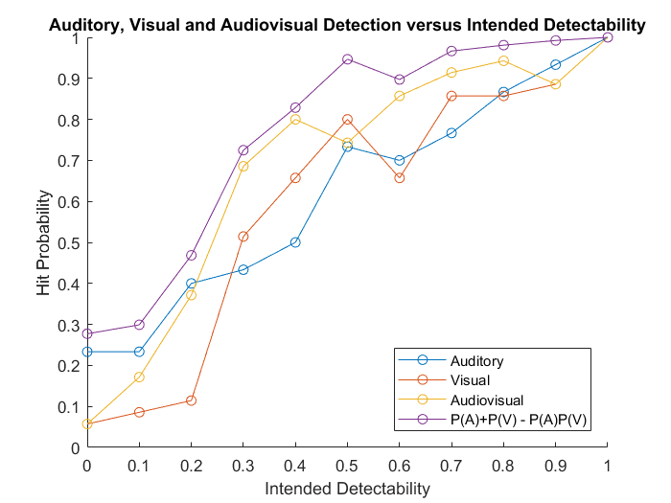
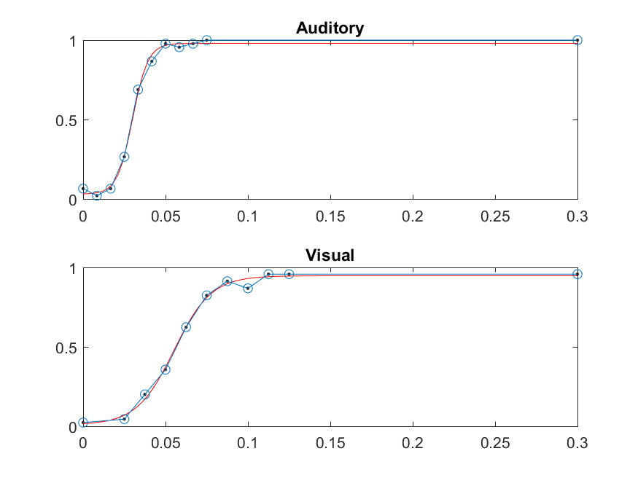
Subject 1
Auditory Glitch
Salvaged Data:
30 reps of each auditory stimulus
25 reps of each visual stimulus
35 reps of each audiovisual stimulus
Notes:
10108007

Slide 4
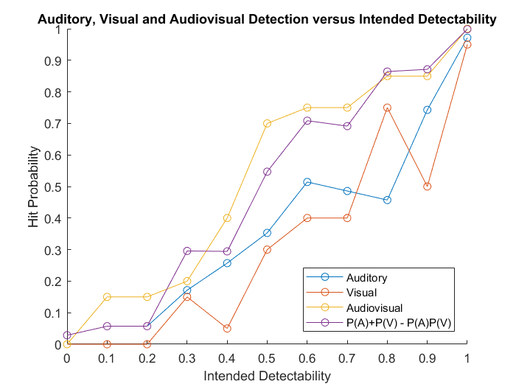
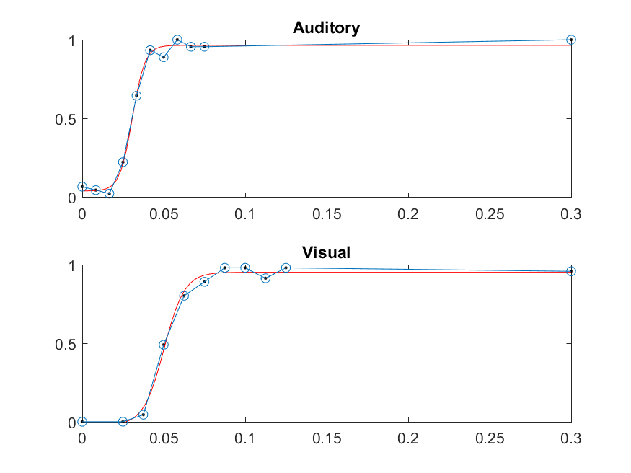
Subject 2
Auditory Glitch
Salvaged Data:
30 reps of each auditory stimulus
20 reps of each visual stimulus
20 reps of each audiovisual stimulus
Notes:
10108008

Slide 5
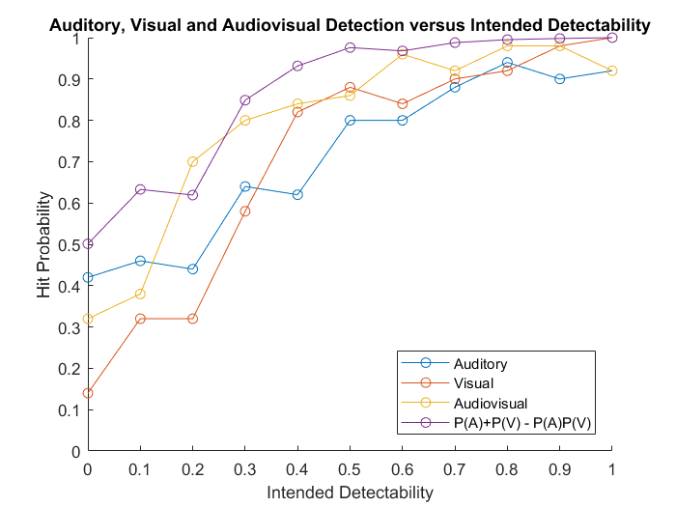
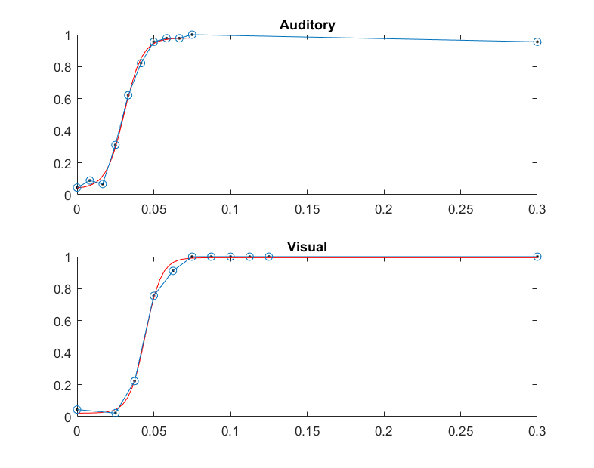
Subject 3
No Auditory Glitch
50 reps of each stimulus
Notes:
10108006

Slide 6
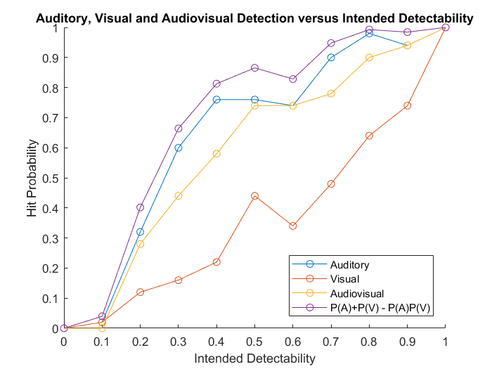
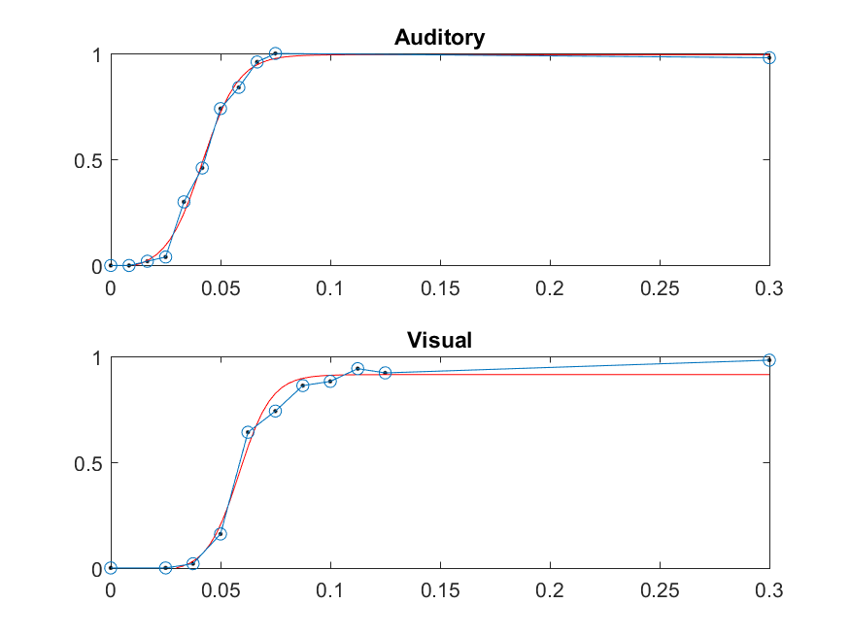
Subject 4
No Auditory Glitch
50 reps of each stimulus
Notes:
10108004

Slide 7
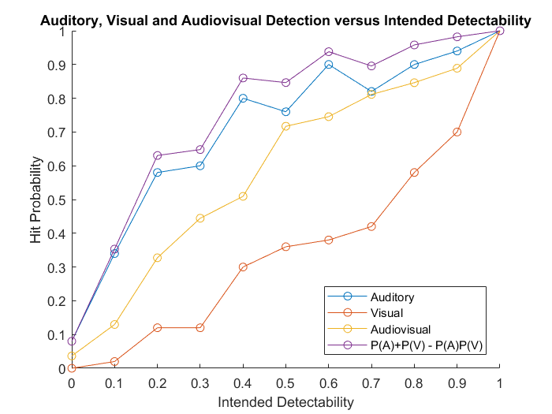
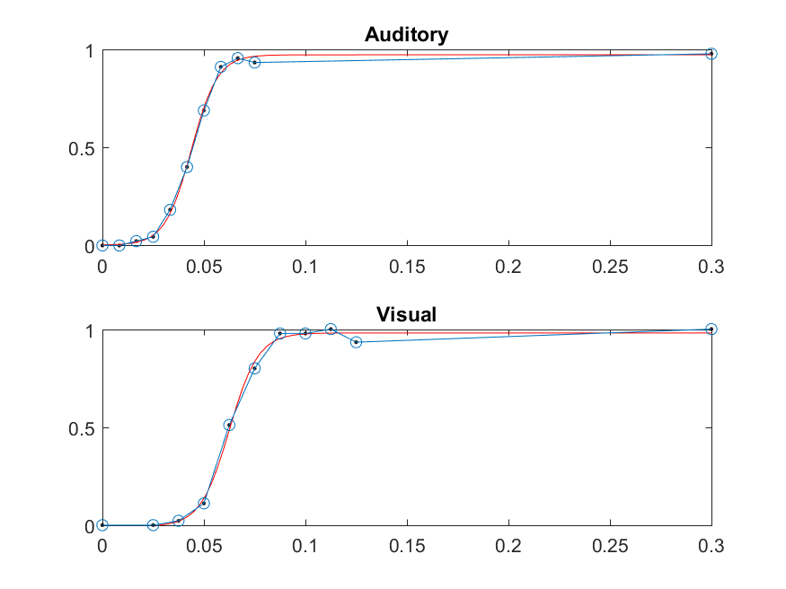
Subject 5
No Auditory Glitch
50 reps of each stimulus
Notes:
10108009

Slide 8
Summary
Behavioral Prediction Model: P(A) + P(V) – P(A)*P(V)
3/5 participants’ audiovisual curve never surpassed probability summation model.
1/5 participants’ audiovisual curve had one point that surpassed the model. (subject 3)
1/5 participants’ audiovisual curve was consistently higher than the probability summation model. (subject 2)
Notes:
10108009

Slide 9
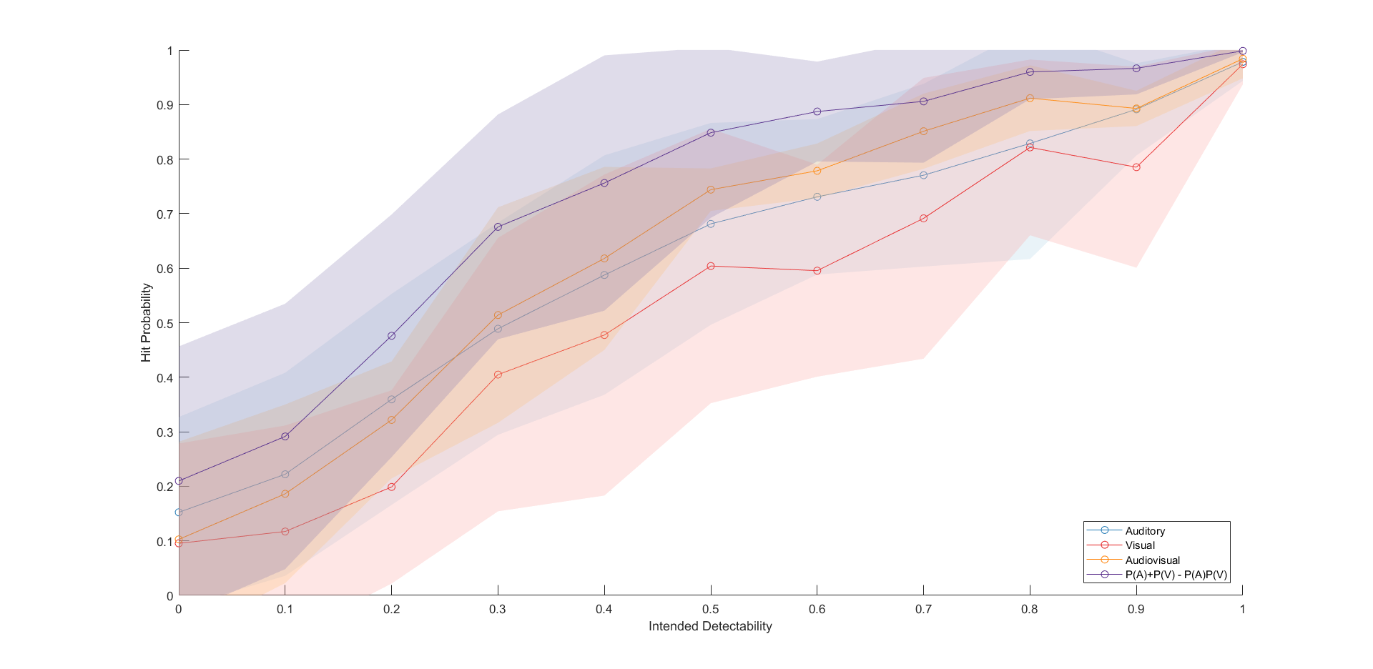
Group Mean ± STD

Slide 10
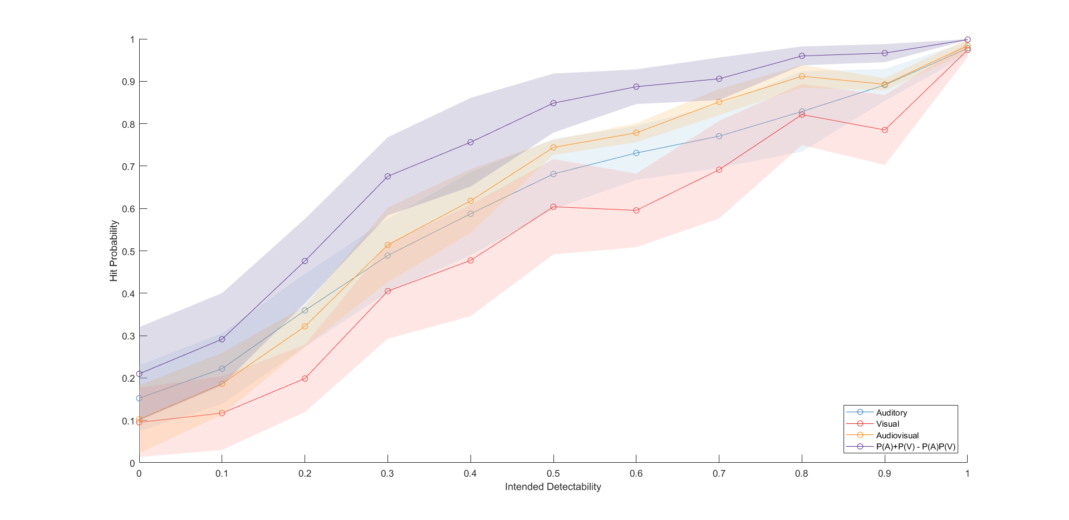
Group Mean ± SEM

